Slide 1
Krill size

Slide 2
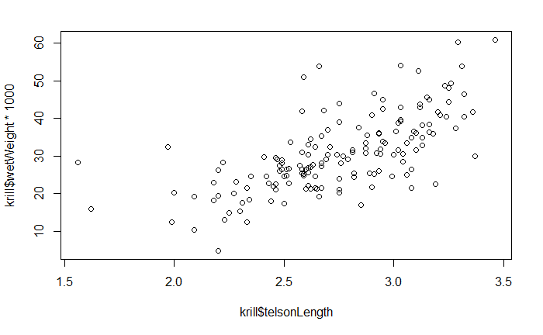
Basic scatter plot of telson length vs. wet weight

Slide 3
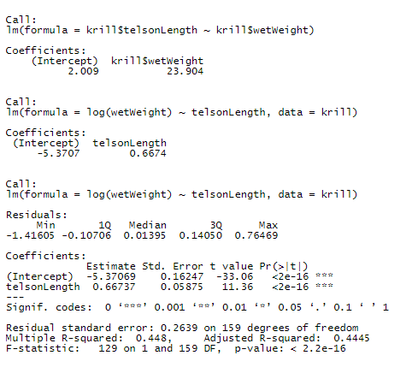
Linear models for length ~ weight + creating body condition

Slide 4
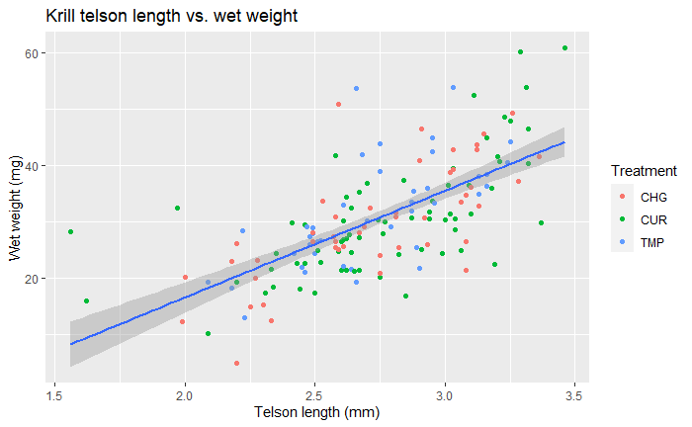
ggplot scatter + treatment

Slide 5
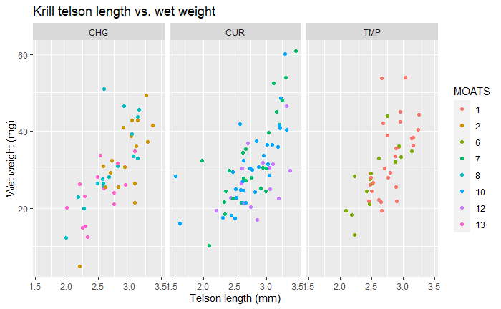
Faceted by treatment

Slide 6
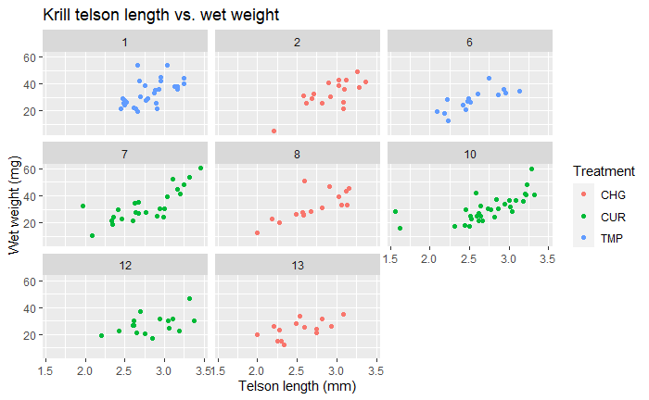
Faceted by MOATS

Slide 7
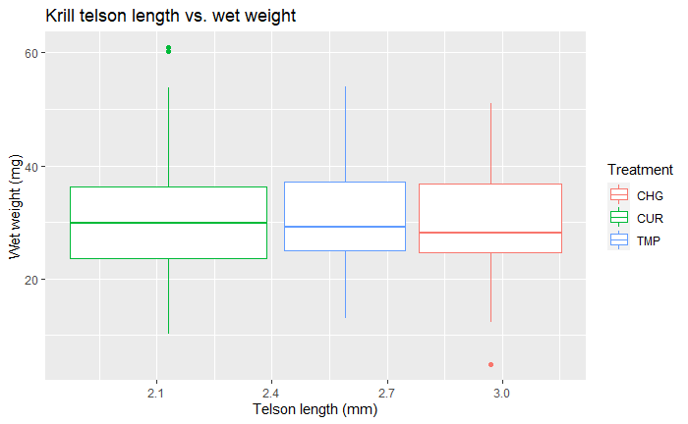
Boxplot by treatment

Slide 8
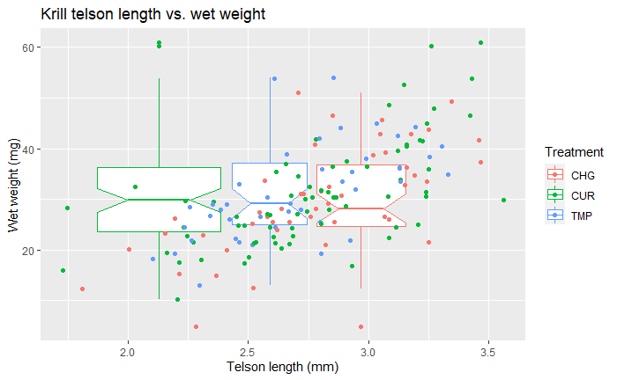
Boxplot by treatment + points

Slide 9
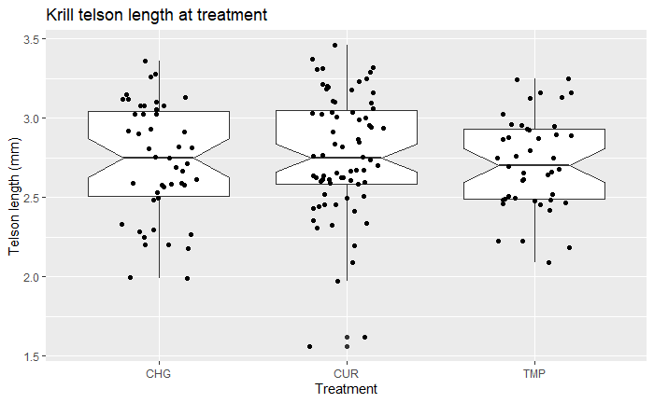
Length at treatment

Slide 10
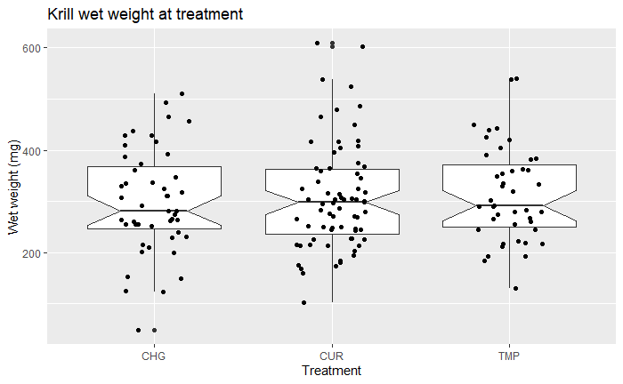
Weight at treatment

Slide 11
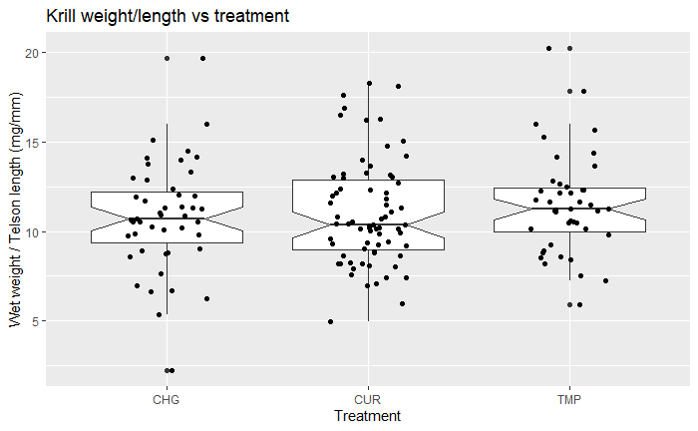
Weight by length at treatment

Slide 12
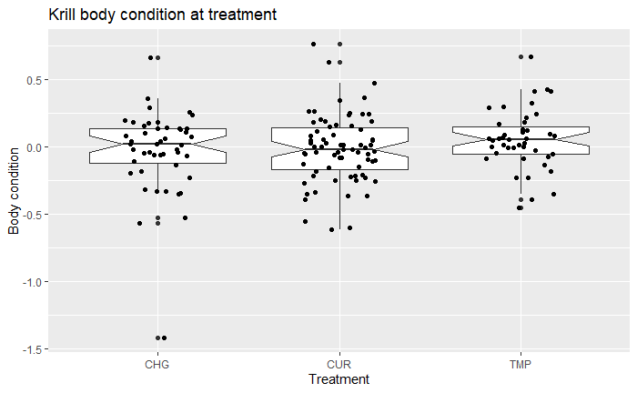
Krill body condition at treatment

Slide 13
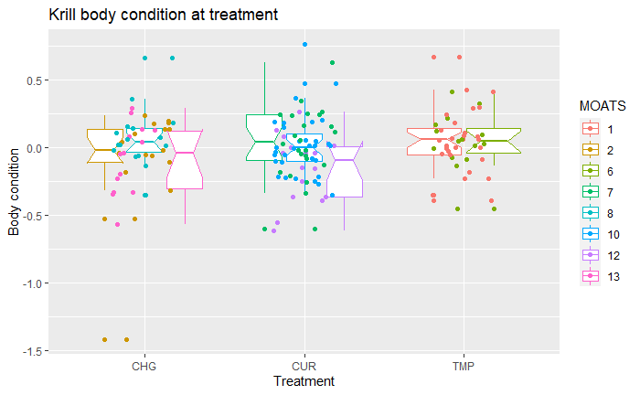
Body condition at treatment by MOATS

Slide 14
Basic stats

Slide 15
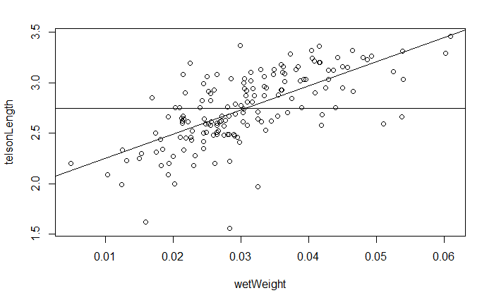
Correlation of telson length and wet weight

Slide 16
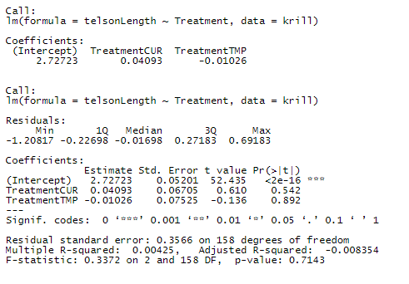
LM of telson length fixed at treatment

Slide 17
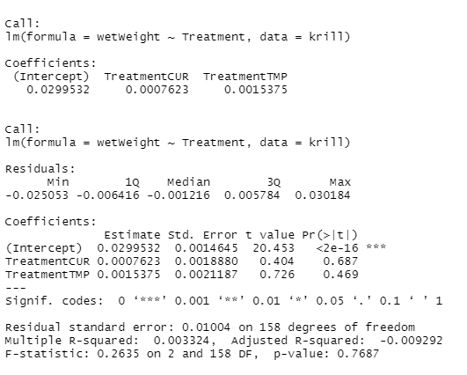
LM of telson weight fixed at treatment

Slide 18
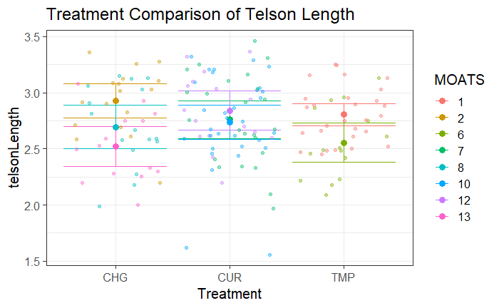
Treatment comparison of TL

Slide 19
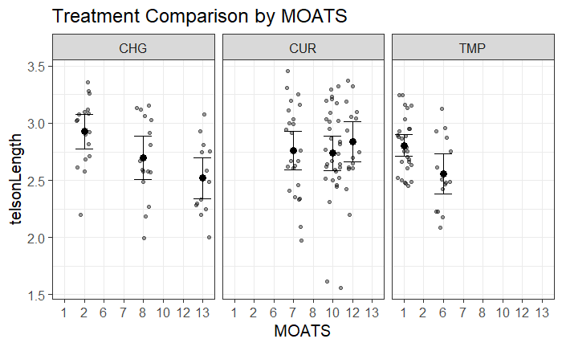
Telson length comparison by MOATS

Slide 20
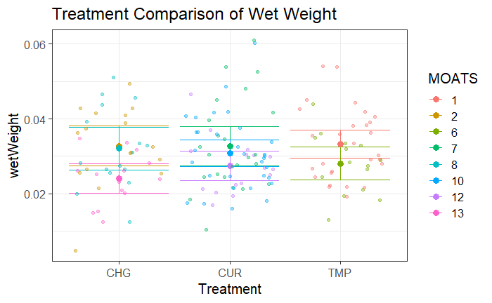
Treatment comparison of weight

Slide 21
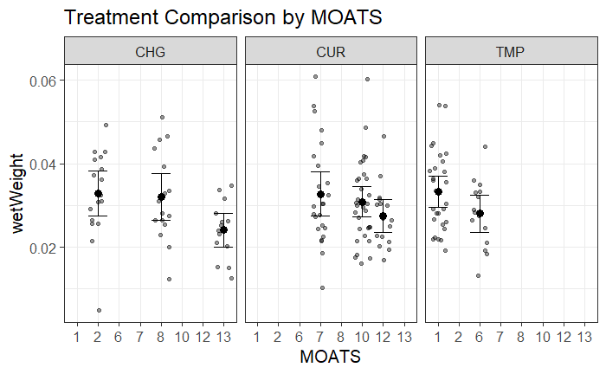
Wet weight comparison by MOATS

Slide 22
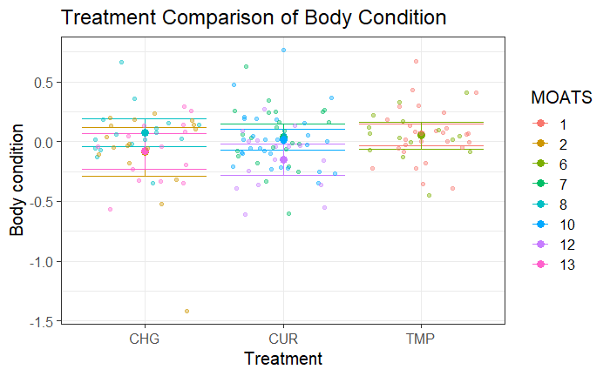
Treatment comparison of body condition

Slide 23
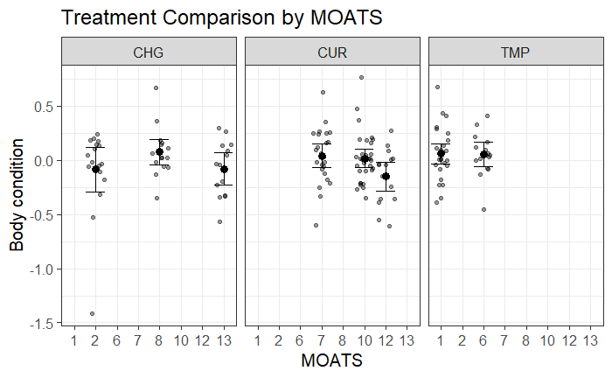
Body condition comparison by MOATS

Slide 24
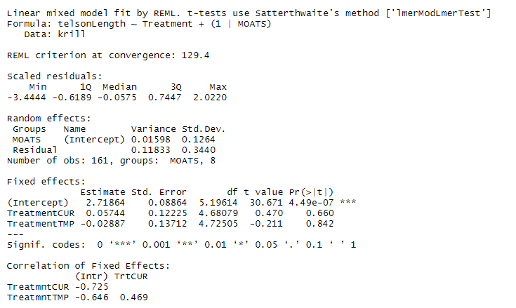
Linear mixed model for telson length

Slide 25
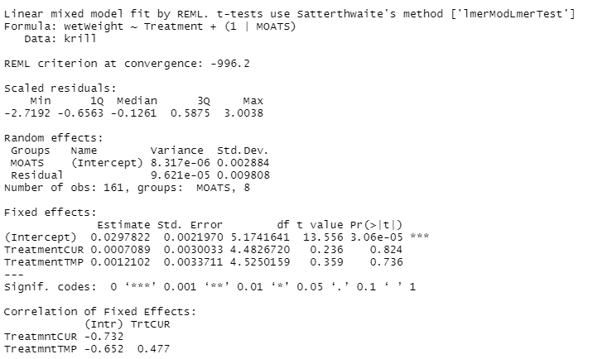
Linear mixed model for wet weight

Slide 26
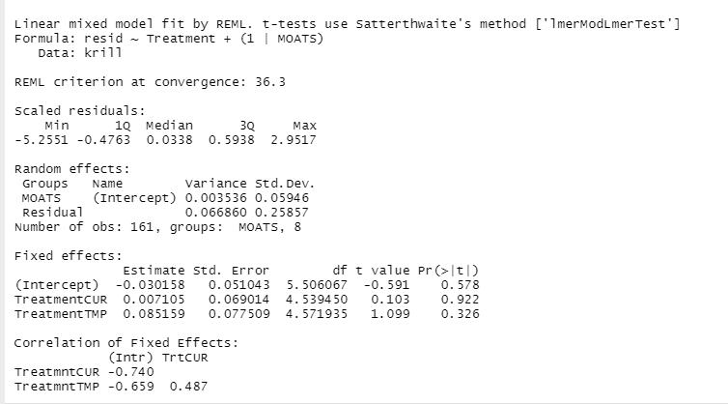
Linear mixed model for body condition

